Slide 1

Project Work - II
Department of Computer Science and Engineering
OFF - CAMPUS Internship
from
“ RWS Moravia India Private Limited”
Submitted To: Submitted By:
Dr. Kailash Chandra Bandhu Pragya Sardar
EN18CS301171

Slide 2

Offer Letter

Slide 3
Contents
Company Profile
Technology You are working on / Learning
Proposed Project
Objective
Scope
Conclusion

Slide 4

About RWS MORAVIA
RWS Moravia is a leading globalization solutions provider, enabling companies in the IT, consumer electronics, retail, media and entertainment, and travel and hospitality industries to enter global markets with high-quality multilingual products and services.
RWS Moravia’s solutions include localization, testing, content creation, machine translation implementations, technology consulting, and global digital marketing services.
Website : https://www.rws.com/

Slide 5




Technologies

Slide 6
Big Data
Big data is a term that describes large, hard-to-manage volumes of data – both structured and unstructured – that inundate businesses on a day-to-day basis.
Big data can be analyzed for insights that improve decisions and give confidence for making strategic business moves.
5 V’s of BIG DATA
Volume
Variety
Velocity
Value
Veracity

Slide 7
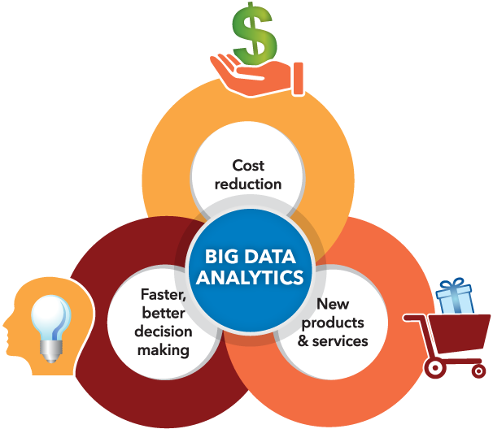
Big Data Analytics
Big data analytics examines large amounts of data to uncover hidden patterns, correlations and other insights.
With today’s technology, it’s possible to analyze your data and
get answers from it almost immediately – an effort that’s
slower and less efficient with more traditional
business intelligence solutions.

Slide 8
Apache Hadoop
Apache Hadoop is an open source, Java-based software platform that manages data processing and storage for big data applications.
Hadoop works by distributing large data sets and analytics jobs across nodes in a computing cluster, breaking them down into smaller workloads that can be run in parallel.
Hadoop can process structured and unstructured data and scale up reliably from a single server to thousands of machines.
COMPONENTS
HDFS – Hadoop Distributed File System
YARN – Yet Another Resource Negotiator
MapReduce

Slide 9
Scala - Scalable Language
Scala combines object-oriented and functional programming in one concise, high-level language.
Scala has been created by Martin Odersky and he released the first version in 2003.
Scala's static types help avoid bugs in complex applications, and its JVM and JavaScript runtimes let you build high-performance systems with easy access to huge ecosystems of libraries.
FEATURES
Object Oriented Language
Statically Typed
Run on JVM
Functional

Slide 10
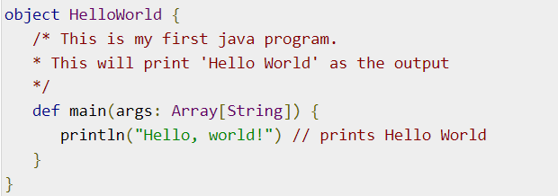

Scala Code
Scala Program Example
Compile and execute the Scala program.
OUTPUT

Slide 11
Apache Spark
Apache Spark is an open-source, distributed processing system used for big data workloads.
It provides development APIs in Java, Scala, Python and R, and supports code reuse across multiple workloads—batch processing, interactive queries, real-time analytics, machine learning, and graph processing.
BENEFITS
A unified engine that supports SQL queries, streaming data, machine learning (ML) and graph processing.
Can be 100x faster than Hadoop for smaller workloads via in-memory processing, disk data storage, etc.

Slide 12
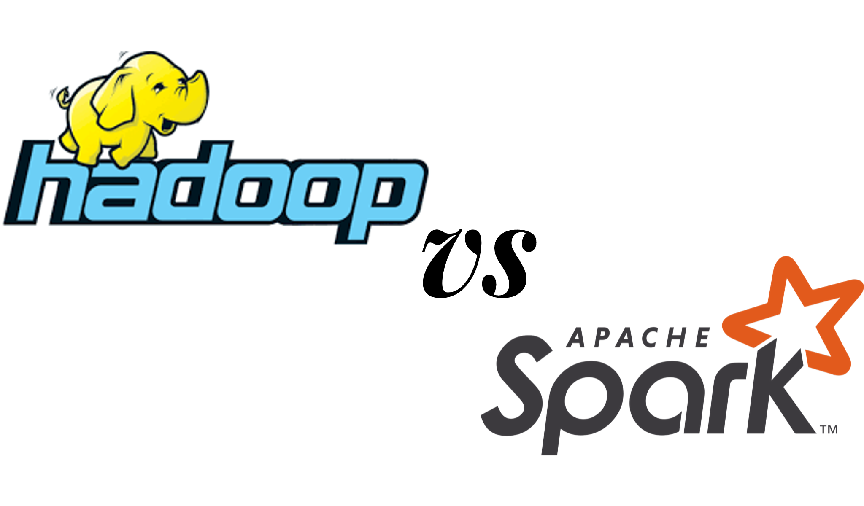
Apache Spark VS Apache Hadoop
Performance
Cost
Processing
Scalability
Security
Machine learning (ML)

Slide 13
Apache Spark VS Apache Hadoop
Performance
Cost
Processing
Scalability
Security
Machine learning (ML)

Slide 14
Proposed Project
Project Title: Link Prediction for Social Networking
Technologies Used: Hadoop, Big Data & Machine Learning

Slide 15
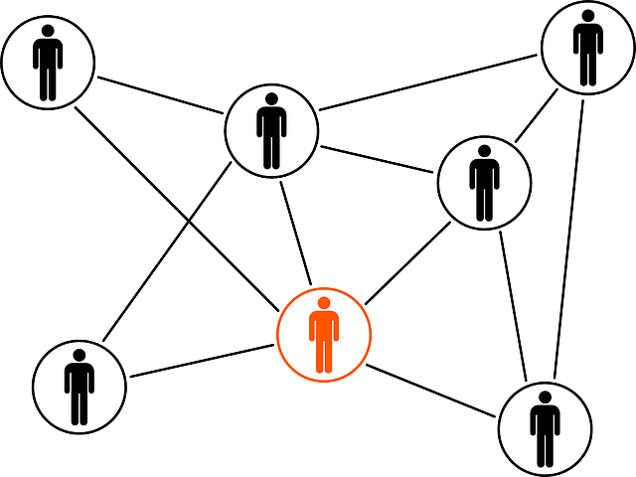
Objective
The objective of link prediction is to identify pairs of nodes that will either form a link or not in the future.

Slide 16
Scope of Proposed Project
Link prediction has a ton of use in real-world applications. Here are some of the important use cases of link prediction:
Predict which customers are likely to buy what products on online marketplaces like Amazon. It can help in making better product recommendations.
Suggest interactions or collaborations between employees in an organization.
Extract vital insights from terrorist networks.

Slide 17
Conclusion
Link prediction and entity resolution are two ways to identify missing information in networks.
Link prediction helps identify edges that are likely to appear in the future, if they do not exist already.

Slide 18
Thank You!

